Slide 1
PYTHON

Slide 2


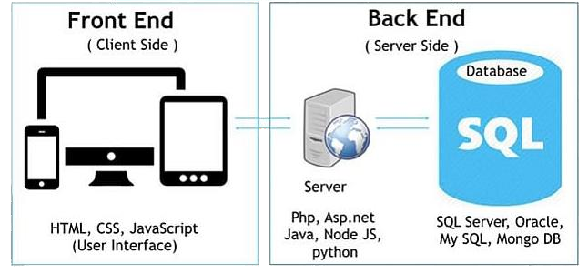
Full Stack Development
We are going to learn
Client side languages, Server side languages, Frameworks, DBMS

Slide 3
INTRODUCTION
General Purpose programming language.
Created by Guido van Rossum in 1991.
Python is interpreted, no need to compile
It is open source and free.
It is an Object Oriented Programming language
It is very easy to learn(easy syntax)

Slide 4
HISTORY
Python laid its foundation in the late 1980s.
The implementation of Python was started in the December 1989 by Guido Van Rossum at CWI in Netherland.
In February 1991, van Rossum published the code (labeled version 0.9.0) to alt.sources.
Python is influenced by following programming languages:
ABC language. Modula-3
Latest stable release 3.9.1 dec 2020

Slide 5
FEATURES
Easy to Learn and Use
Interpreted Language
Free and Open Source
Object-Oriented Language
Expressive Language E.g.: In C
#include<stdio.h>
#include<conio.h> void main()
{
printf(“Hello World”);
getch();
}

Slide 6
In python
print(“Hello World”)
Cross Platform Language
Extensible Language
Large Standard Library
Dynamic Memory Allocation
E.g.: In C
int a;
int a=10;
E.g.: In Python
a=10

Slide 7
PYTHON
Used for:-
Web development
Machine learning
Data analysis/visualization,
Webscrapping
Game development
Desktop app
Embedded app

Slide 8




JOB OPPORTUNITIES
Software Engineer Web Developer Data Analyst Data Scientist
Software Developer Machine Learning Engineer
SITES
Instagram YouTube Google

Slide 9

ENVIRONMENTAL SETUP
Python IDLE-Integrated Development And Learning Environment
Visit the link https://www.python.org/downloads/ to download the latest release of Python.
Add Python to Path Visual Studio Code
Visit the link https://code.visualstudio.com/download and download.

Slide 10
Run a program:
Using Interactive interpreter prompt Using a scriptfile
input() print() Comment indentation

Slide 11
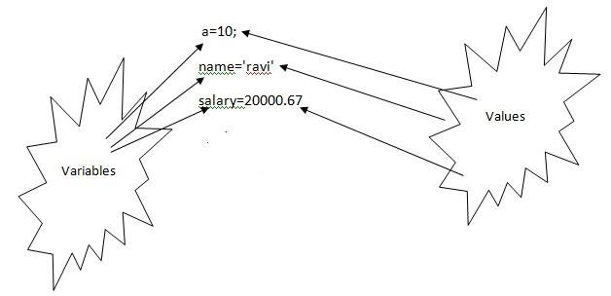
Variables
name which is used to refer memory location. variable used to hold value.
don't need to specify the type of variable.

Slide 12
Python Identifiers
starts with a letter A to Z or a to z or an underscore (_) followed by zero or more letters,
underscores and digits (0 to 9).
No special characters @, $, and %within identifiers. Do not start with digits; use digits in between or end. Case sensitive programminglanguage.
Class names start with an uppercase letter.
Al other identifiers start with a lowercase letter.
Starting with a single leading underscore -private.
Starting with two leading underscores -strongly privateidentifier.
Keywords reserved and cant be used as identifier.

Slide 13


Data types
Immutable Integer Float Boolean String Tuple
Mutable
List Set
Dictionary
type() function which returns the type of the variable passed.

Slide 14
KEYWORDS
and | exec | not
assert | finally | or
break | for | pass
class | from | print
continue | global | raise
def | if | return
del | import | try
elif | in | while
else | is | with
except | lambda | yield

Slide 15
Operators
responsible for a particular operation between two operands Arithmetic operators
Comparison operators Assignment Operators
Logical Operators
Bitwise Operators Membership Operators Identity Operators

Slide 16
Arithmetic operator
Operator | Description
+ (Addition) | It is used to add two operands. For example, if a = 20, b = 10 => a+b = 30
- (Subtraction) | It is used to subtract the second operand from the first operand. If the first operand is less than the second operand, the value result negative. For example, if a = 20, b = 10 => a - b = 10
/ (divide) | It returns the quotient after dividing the first operand by the second operand. For example, if a = 20, b = 10 => a/b = 2
* (Multiplication) | It is used to multiply one operand with the other. For example, if a = 20, b = 10 => a * b = 200
% (reminder) | It returns the reminder after dividing the first operand by the second operand. For example, if a = 20, b = 10 => a%b = 0
** (Exponent) | It is an exponent operator represented as it calculates the first operand power to second operand.
// (Floor division) | It gives the floor value of the quotient produced by dividing the two operands.

Slide 17
Comparison operator
Operator | Description
== | If the value of two operands is equal, then the condition becomestrue.
!= | If the value of two operands is not equal then the condition becomestrue.
<= | If the first operand is less than or equal to the second operand, then the condition becomes true.
>= | If the first operand is greater than or equal to the second operand, then the condition becomes true.
> | If the first operand is greater than the second operand, then the condition becomes true.
< | If the first operand is less than the second operand, then the condition becomes true.

Slide 18
Assignment Operator
Operator | Description
= | It assigns the the value of the right expression to the left operand.
+= | It increases the value of the left operand by the value of the right operand and assign the modified value back to left operand. For example, if a = 10, b = 20 => a+ = b will be equal to a = a+ b and therefore, a = 30.
-= | It decreases the value of the left operand by the value of the right operand and assign the modified value back to left operand. For example, if a = 20, b = 10 => a- = b will be equal to a = a- b and therefore, a = 10.
*= | It multiplies the value of the left operand by the value of the right operand and assign the modified value back to left operand. For example, if a = 10, b = 20 => a* = b will be equal to a = a* b and therefore, a = 200.
%= | It divides the value of the left operand by the value of the right operand and assign the reminder back to left operand. For example, if a = 20, b = 10 => a % = b will be equal to a = a % b and therefore, a = 0.
**= | a**=b will be equal to a=a**b, for example, if a = 4, b =2, a**=b will assign 4**2 = 16 to a.
//= | A//=b will be equal to a = a// b, for example, if a = 4, b = 3, a//=b will assign 4//3 = 1 to a.

Slide 19
Bitwise Operator
Operator | Description
& (binary and) | If both the bits at the same place in two operands are 1, then 1 is copied to the result. Otherwise, 0 is copied.
| (binary or) | The resulting bit will be 0 if both the bits are zero otherwise the resulting bit will be 1.
^ (binary xor) | The resulting bit will be 1 if both the bits are different otherwise the resulting bit will be 0.
~ (negation) | It calculates the negation of each bit of the operand, i.e., if the bit is 0, the resulting bit will be 1 and vice versa.
<< (left shift) | The left operand value is moved left by the number of bits present in the right operand.
>> (right shift) | The left operand is moved right by the number of bits present in the right operand.

Slide 20
Logical Operator
Operator | Description
and | If both the expression are true, then the condition will be true. If a and b are the two expressions, a → true, b → true => a and b → true.
or | If one of the expressions is true, then the condition will be true. If a and b are the two expressions, a → true, b → false => a or b → true.
not | If an expression a is true then not (a) will be false and vice versa.

Slide 21
Membership Operator
Operator | Description
in | It is evaluated to be true if the first operand is found in the second operand (list, tuple, or dictionary).
not in | It is evaluated to be true if the first operand is not found in the second operand (list, tuple, or dictionary).

Slide 22
Identity Operator
Operator | Description
is | It is evaluated to be true if the reference present at both sides point to the same object.
is not | It is evaluated to be true if the reference present at both side do not point to the same object.

Slide 23



CONDITIONAL STATEMENTS
IF
if condition :
# code to be executed
IF-ELSE
if condition:
# code to be executed
else:
#code to be executed
IF-ELIF-ELSE
if expression 1:
# code to be executed
elif expression 2:
# code to be executed
elif expression 3:
# code to be executed
else:
# code to be executed

Slide 24


LOOPS
It provides code re-usability.
Using loops, we do not need to write the same code again and again.
Using loops, we can traverse over the elements of data structures (array or linked lists).
While
else block- is executed when the condition given in the while statement becomes false. Like for loop, if the while loop is broken using break statement, then the else block will not be executed and the statement present after else block will be executed.
For
else statement with the for loop can be executed only when all the iterations are exhausted. If the loop contains any of the break statement then the else statement will not be executed.

Slide 25



pass statement in Python is used when a statement is required syntactically
but you do not want any command or code to execute.
break statement in Python terminates the current loop and resumes
execution at the next statement, just like the traditional break found in C.
continue statementrejec tsal the remaining statementsin the current
iteration of the loop and moves the control back to the top of the loop.

Slide 26
POP vsOOP
PROCEDURAL ORIENTED PROGRAMMING | OBJECT ORIENTED PROGRAMMING
Inprocedural programming, program isdivided into small parts called functions. | Inobject oriented programming, program isdivided into small parts called objects.
Procedural programmingfollows top down approach. | Object oriented programming follows bottom up approach.
There is no access specifier inprocedural programming. | Object oriented programming have access specifiers like private, public, protectedetc.
Adding new data and function is not easy. | Adding new data and function is easy.
Procedural programming does not have any proper way for hiding data so it is less secure. | Object oriented programming providesdata hiding so it is more secure.
In procedural programming, overloadingisnot possible. | Overloading is possible in object oriented programming.
In proceduralprogramming, function is more important thandata. | Inobject oriented programming, data is more important than function.
Procedural programming isbased on unreal world. | Object oriented programming isbased on real world.
Examples: C, FORTRAN, Pascal, Basic etc. | Examples: C++,Java, Python, C# etc.

Slide 27
Strings
"hello"+"world" "hello"*3 "hello"[0]
"hello"[-1]
"hello"[1:4]
len("hello") "hello" < "jello" "e" in "hello"
"helloworld" # concatenation
"hellohellohello" # repetition
"h"
"o"
"ell"
5
1
1
# indexing
# (from end)
# slicing
# size
# comparison
# search

Slide 28
Modify String
a.lower()
a.upper()
Removing Whitespace
Strip() eg:: a.strip()
Replacing String
Replace eg:: a.replace("H", "J")
Split string
Split() eg:: a.split(",")

Slide 29
More List Operations
>>> a = range(5)
>>> a.append(5)
>>> a.pop() 5
>>> a.insert(0, 42)
>>> a.pop(0) 5.5
>>> a.reverse()
>>> a.sort()
# [0,1,2,3,4]
# [0,1,2,3,4,5]
# [0,1,2,3,4]
# [42,0,1,2,3,4]
# [0,1,2,3,4]
# [4,3,2,1,0]
# [0,1,2,3,4]

